Slide 1
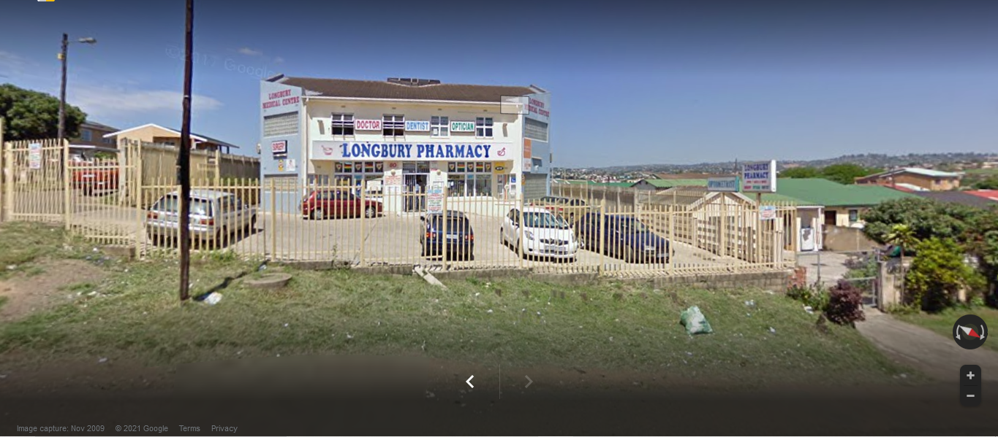
LONGBURY DENTAL SURGERY SYSTEM

Slide 2
INTRODUCTION:
-The System is mainly about appointment scheduling
-User friendly System.
-Automatic tasks
-Pharmacology industry requires adequate system

Slide 3
NON- FUNCTIONAL REQUIREMENT
-Reliability
-recovery from failure
-response in time

Slide 4
Functional Requirement
-Order management and communication
-Administration
-Intervention and monitoring

Slide 5
LIST OF FEATURES
Feature Description | User Profile | Priority (Low/Medium/High) | No of Weeks/Days to develop
System login | Manager/Staff | high
Add new users | Manager | High | 3 days
Add new treatment | Staff | Medium | 3 days
Add Images to Patient, Dentist and User | Manager, Staff | high | 2 days
View and search Prescription | Manager, Staff | high | 2 days
View and search treatments | Manager, Staff | medium | 2 days
Add/delete/update Payment Details | Manager, Staff | high | 4 days
Add/delete/update Treatment Details | Manager ,Staff | High | 4 days
Add/delete/update Prescription Details | Manager ,Staff | high | 4 days
Add/delete/update Dentist Details | Manager ,Staff | high | 4 days
Add/delete/update Appointment | Staff | high | 4 days
View and search Appointments | Manager, Staff | medium | 2 days
Splash | System | Low | 1 days
Generate/ View reports | Manager , Staff | High | 4 days

Slide 6
User Stories
1. A Dentist has to be registered so he/she can be assigned to an appointment.
2. A customer has to make an appointment in order to see the dentist.
3. A prescription is added cause it has to be assigned to a patient by a dentist.
4. A treatment exist so it can administered by Dentist
5. A picture is assigned to a customer so they can be easily identifiable.

Slide 7
Logical models

Slide 8
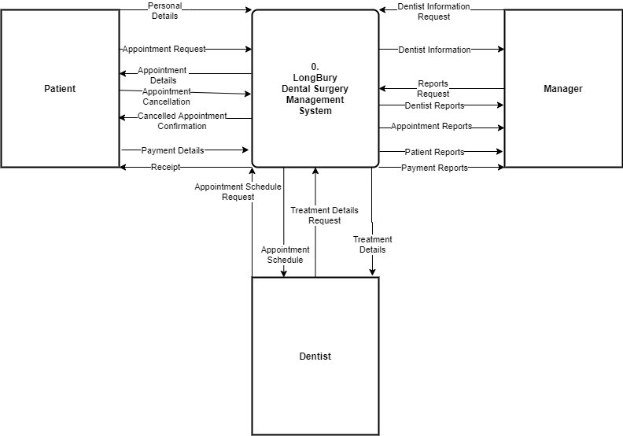
CONTEXT-LEVEL DFD

Slide 9
LEVEL-0 DFD

Slide 10
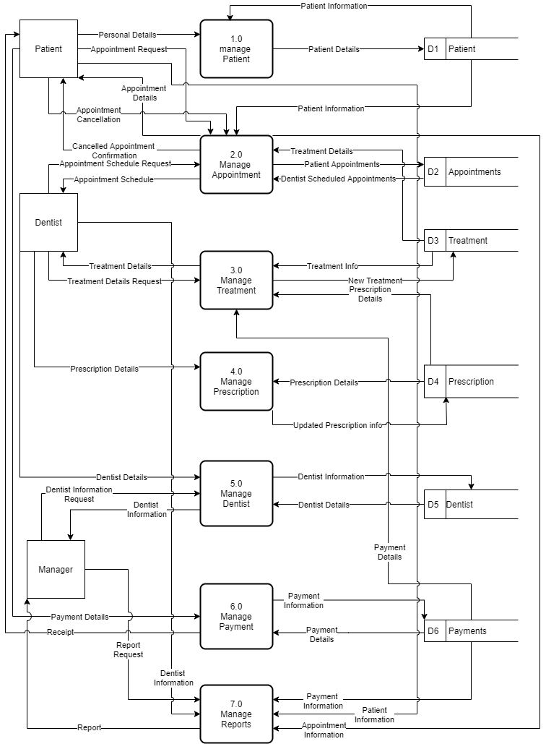

Slide 11
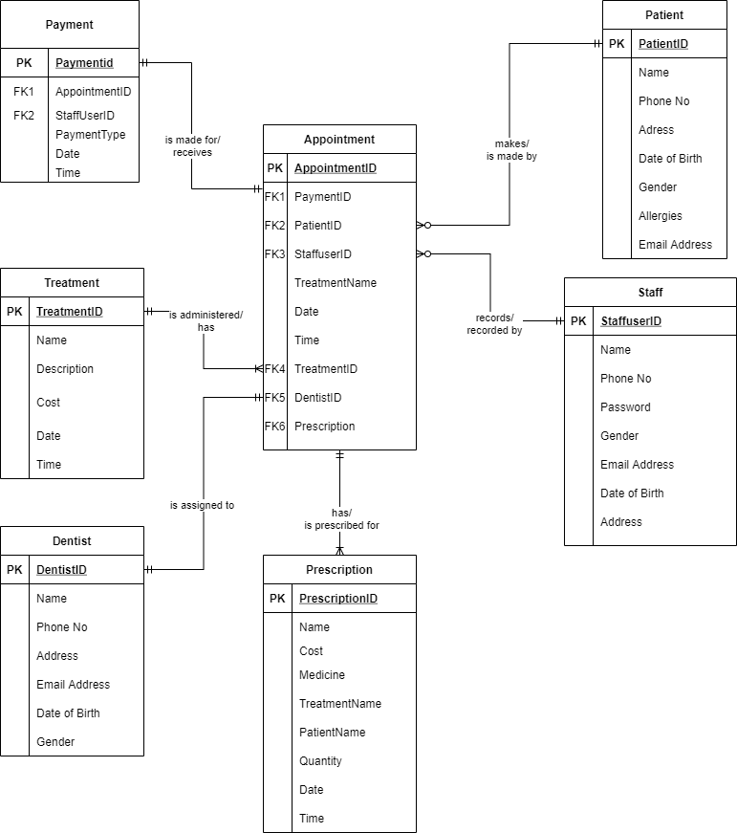
Entity Relationship Diagram

Slide 12
THE END
THANK U SO MUCH

